Slide 1

Competitive Programming From Problem 2 Solution in O(1)
P
T
H
I
N
K
F
A
S
T
S
C++: Streams and Files
Mostafa Saad Ibrahim
PhD Student @ Simon Fraser University

Slide 2
Console so far
So far we were reading/writing to console
Imagine company with 1000 employees, we need to have them saved somewhere on disk
When program load, it read the current data
If we updated the data, we save them to disk
This is where Streaming from/to hard disk (or any permanaet storage) appears

Slide 3
Input and output file streams
A stream is a flowing sequence of characters.
Input stream: Read characters from a source
Output stream: Write characters to a source
Source can be many things
Screen (e.g. Output) and Keyboad (e.g. Input)
File
String
...

Slide 4
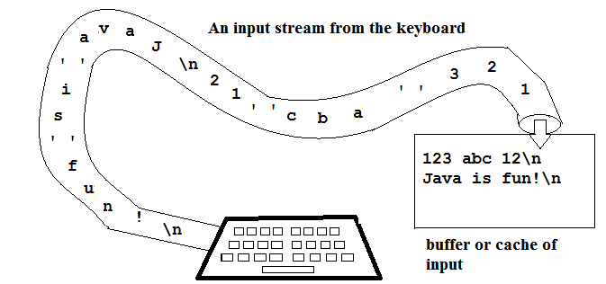
Input and output file streams
Src: http://pages.cs.wisc.edu/~cs302-2/resources/handouts/input_stream.png

Slide 5
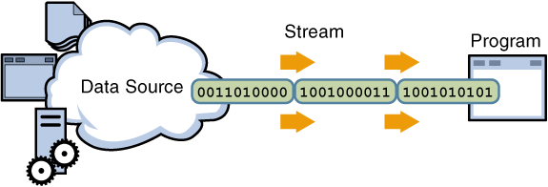

Input and output file streams
Input Stream
Output Stream
Src: http://java.icmc.usp.br/books/ooc/html/oop_in_java_input_output_streams.html

Slide 6
Available Streams
cin: Defined object for standard input stream
cout: Defined object for standard ouput stream
cerr: Defined object for standard error output stream
clog: Defined object for standard logging output stream
All these objects defined inside
#include <iostream>

Slide 7
Output streams note
Output can be buffered or unbuffered
Buffered: accumulate output till buffer is filled, then do an output
Fast + Late flushing . It meansyou don’t get output to console/file on time..later flushed
Unbuffered: If you asked to output, it output content directly. Slow + Direct flushing (Helps in crash)
cout and clog are buffered. cerr is unbuffered.

Slide 8
Output streams note
cout<<something<<endl;
endl forces flushing
Again may cause performance issue
But good for craches
cout<<something<<“\n”;
\n doesn’t force flushing
endl equal to cout<<something<<“\n”<<flush;

Slide 9
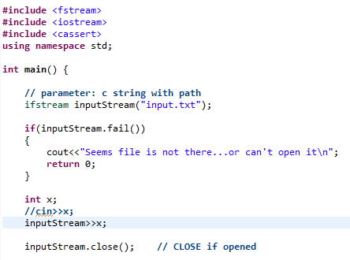
Input stream on a file

Slide 10
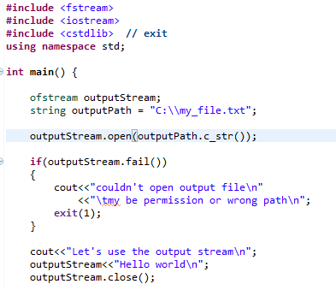
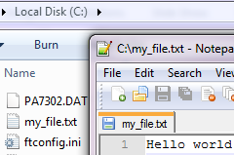
Output stream on a file

Slide 11
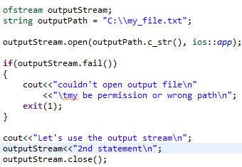
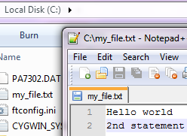
Output stream on a file

Slide 12
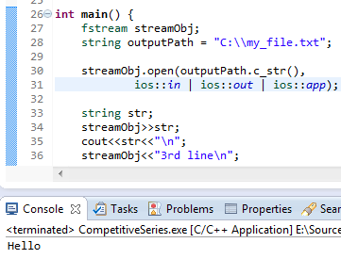
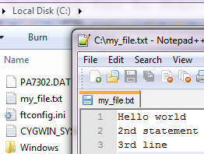
Input-output stream on a file

Slide 13
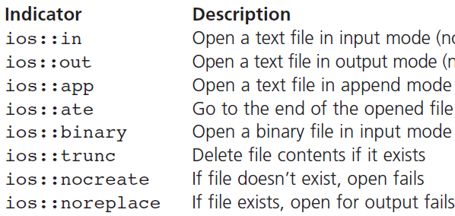
File modes
Src: A first book c++

Slide 14
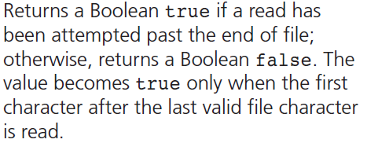
More methods: Eof
Src: A first book c++

Slide 15
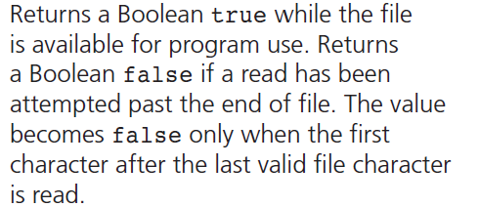
More methods: Good
Src: A first book c++

Slide 16
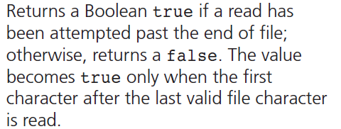
More methods: Bad
Src: A first book c++

Slide 17
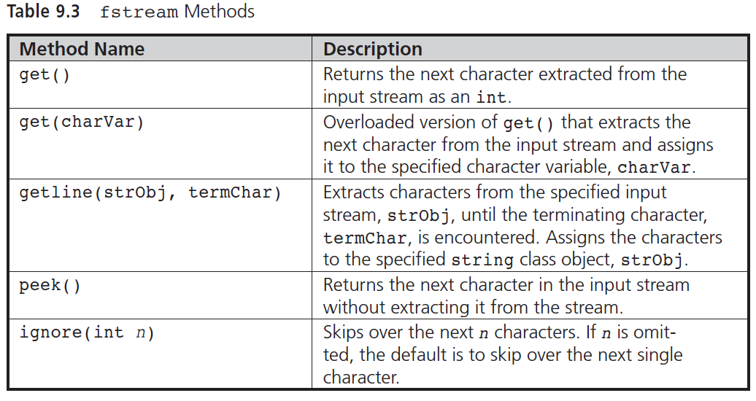
More methods

Slide 18
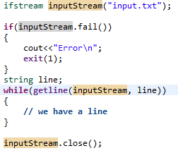
Reading whole file: Ex 1

Slide 19
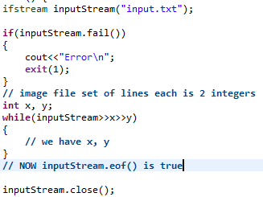
Reading whole file: Ex 2

Slide 20
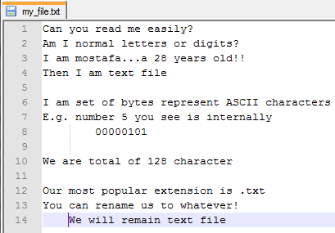
What is Text File?

Slide 21

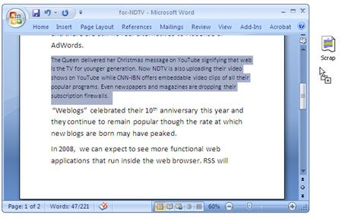
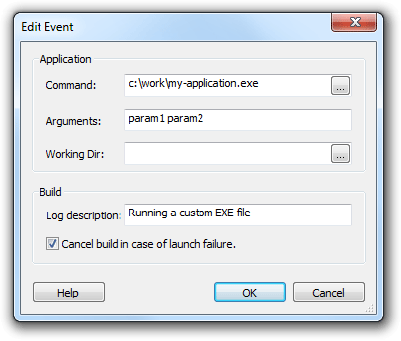


What is Binary File?
Notes:
Src:
http://fileinfo.com/help/binary_vs_text_files
http://img.labnol.org/images/2008/01/microsoft-word-scrapbook.jpg

Slide 22
Binary File
Internally also is written bytes, but up to 256 types
Not readable. More combact representation
String 230 need 3 bytes in ascii, but 1 only in binary
Usually programs (e.g. Word) are binary files
This means to read this file, you must know what each byte means

Slide 23
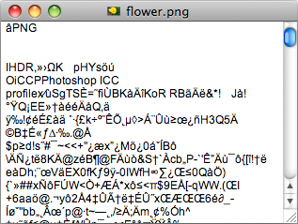
Open binary file with text editor
Src: http://fileinfo.com/help/binary_vs_text_files

Slide 24
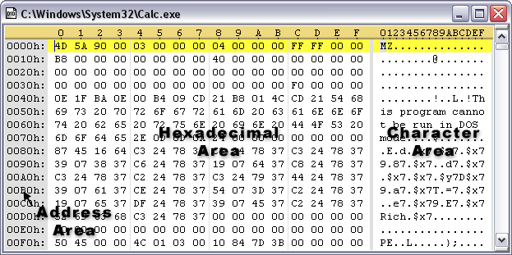
Open Binary with hex editor
Src: http://www.sweetscape.com/graphics/ArtHexEditor.GIF

Slide 25
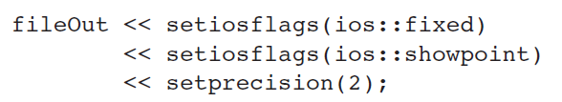
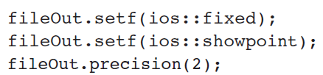
Think same as cin-cout
fileIn >> ws; // eat up any leading white spaces
char c = fileIn.peek();

Slide 26
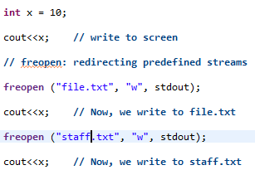
Freopen

Slide 27
تم بحمد الله
علمكم الله ما ينفعكم
ونفعكم بما تعلمتم
وزادكم علماً

